Slide 1
Capgemini Cafe

Slide 2
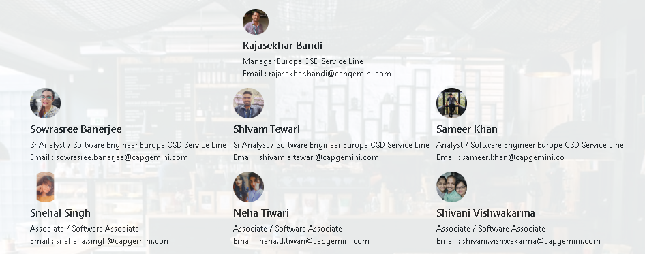
Our Team

Slide 3
Description
An application which will be exclusively for Capgemini employees.
User must be able to view the café list along with the details like location and menu.
User must be able to sort and fetch café by various details.
User must be able to access the helpdesk, raise a ticket and view it.
The cart and payment page must be unique.

Slide 4
Technologies
Backend
Spring REST / ASP.NET
PostgresSQL
Frontend
Angular, HTML, CSS, Bootstrap, ReactJS
Deployment
Web

Slide 5
Roadmap
Phase 1
Design and Analysis of the problem statement.
Creating the documents.
Creating the backend of the application.
Phase 2
Coding and Testing of the frontend.
Phase 3
Integration and Deployment of the application.
Bug Fixing.

